Slide 1
Development Platforms and Frameworks
IoT Lecture Series
Prof. John Lee
IUPUI & KAIST

Slide 2
Purpose of Talk
Introduce various IoT platforms and frameworks
that mostly I have tried to use
To utilize them better
To develop better ones

Slide 3
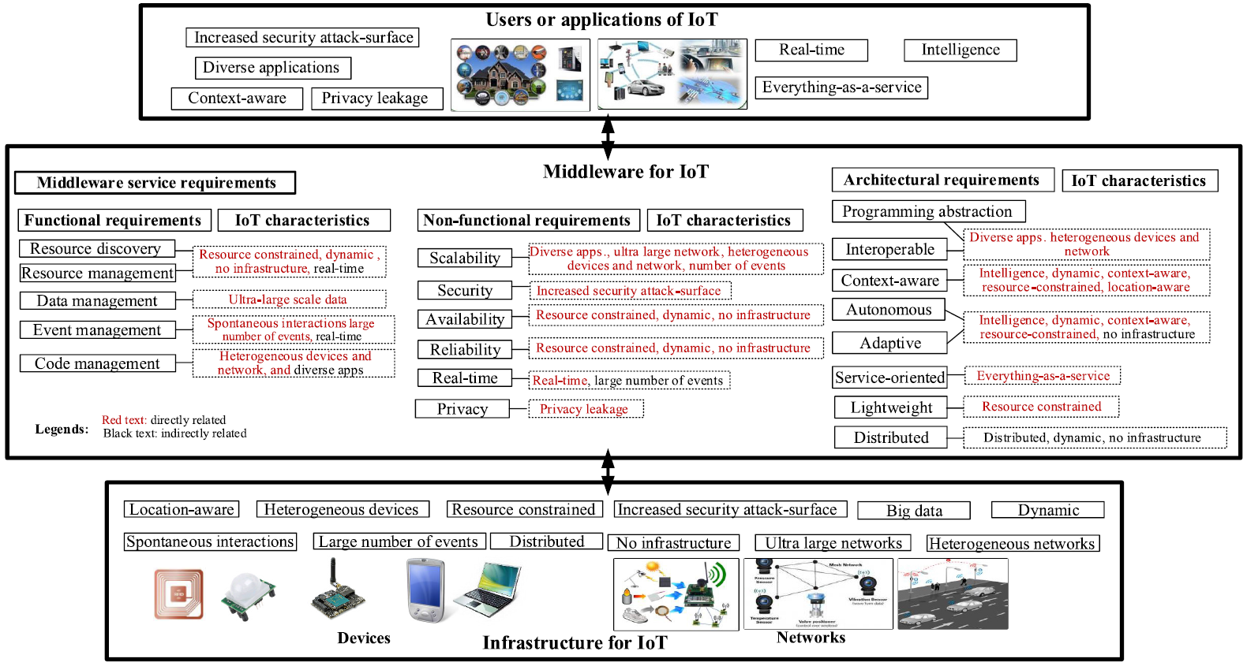
IoT Characteristics & Requirements
Ref: Middleware for Internet of Things-A Survey

Slide 4
Characteristics of IoT
Too many devices
Heterogeneous devices
Too many protocols
Resource-constrained
Power-constrainedSpontaneous interactions
Ultra-large-scale network and large number of events
Dynamic network and no infrastructure

Slide 5
IoT System Key Requirements
Resource discovery and management
Data management
Event management
Context-aware / situation-aware / location-aware
Capable of connecting heterogenous everything
Overcoming the resource-constrained
Code management (e.g., code deployment and migration)

Slide 6
IoT Architectural Requirements
Programming abstraction (APIs, etc.)
Interoperable
Service-based
Adaptive
Autonomous
Context-aware
Distributed

Slide 7
IoT Key Nonfunctional Requirements
Scalability
Real-time or timeliness
Reliability
Availability
Security and privacy
Ease-of-development
Popularity

Slide 8
IoT Development Platforms/Frameworks
ThingWorx
Hierarchical modeling of things
Complete detailed GUI-based configuration of things, events, subscriptions, services, widgets, and mashups (webpages)
Node-RED
Node.js-based visual rapid prototyping tool for wiring the IoT
AT&T IoT Platform
Node-RED integrated M2M development and service platform
IBM Bluemix
open source Platform as a Service (PaaS)
Amazon AWS
70+ Amazon Web Services (compute, storage, networking, database, analytics, application services, deployment, management, mobile, developer tools, and tools for the IoT)

Slide 9

IoT Development Platforms/Frameworks
SiteWhere - multiple IoT applications can be served from a single SiteWhere instance
http://www.sitewhere.org/
ThingSpeak - open IoT platform with MATLAB analytics
Temboo – auto-code generator and service platform
AllJoyn - framework for distributed applications
https://allseenalliance.org/developers/learn/architecture
OpenHAB - Home Automation and IoT gateway framework
http://OpenHAB.org

Slide 10
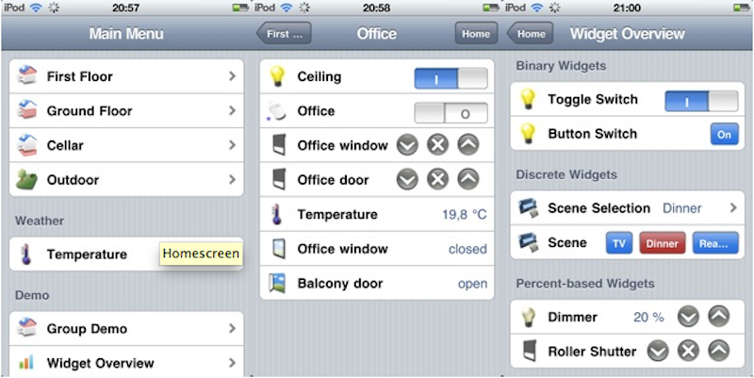
OpenHAB Home Automation Development Framework
http://www.OpenHAB.org/
Based on Eclipse Java EE
UI interface can be easily configured

Slide 11
OpenHAB Home Automation Hub
To connect all kinds of
home electronics
appliances
alarm system
custom-built IoT devices

Slide 12
OpenHAB basics
FOSS automation software
FOSS: free and open-source software
Eclipse Public License 1.0
Written mostly in Java
Central automation hub
Hardware/protocol agnostic
Many bindings http://www.OpenHAB.org/features-tech.html
Component-based architecture
Each component is an OSGi bundle

Slide 13
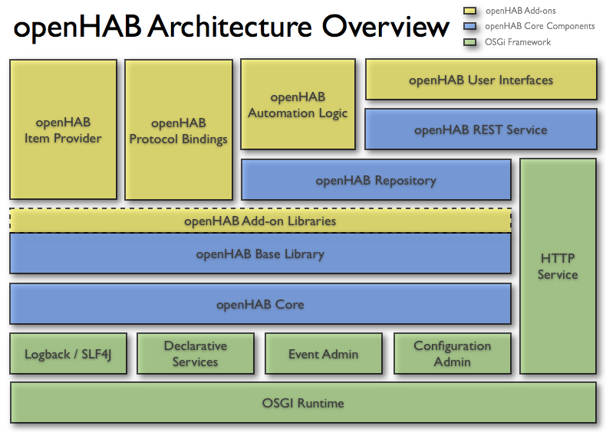

Slide 14
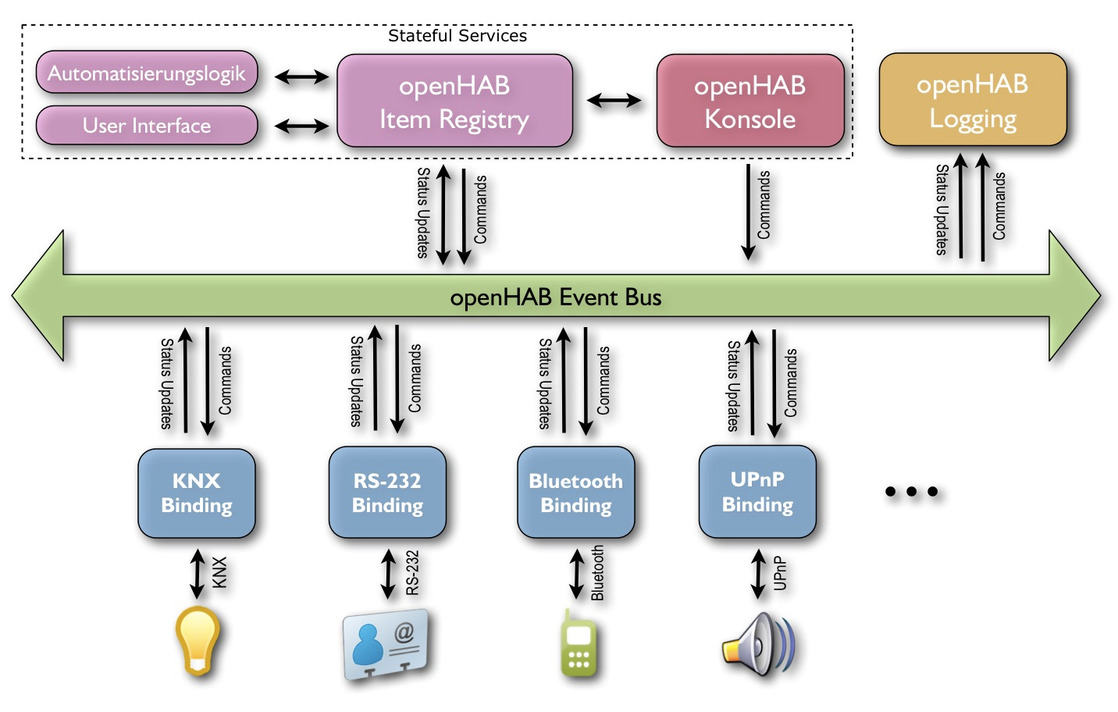
OpenHAB Architectural Connection
Automation Logic
openHAB
Item Repository
openHAB Console
User Interface

Slide 15
OpenHAB Architectural Connection
Event bus
Asynchronous communication bus
Repository
Persistent storage
Items
Objects that can be read or written
Have a type and state
Bindings
Translate event bus events to/from external system
Actions
Programmatic methods available for use by scripts/rules

Slide 16
OpenHAB features
Plugin framework
Rules engine
Logging mechanism
UI abstraction with text-based description
Sitemap - Tree structure of UI widgets
Items (switches, lamps, devices, services)
Rules (enables more complex conditional behaviors)
Item UI Providers - Dynamic UI configuration
Open Source GUIs (browser, Android, iOS, HTTP)
Designer tool - graphic configuration of runtime
Paper-UI supports device discovery

Slide 17
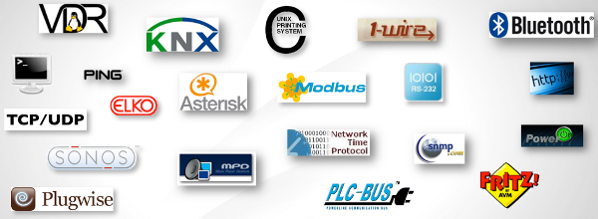
Connectable Protocols & Devices
Bluetooth, Serial, Zwave, AllJoyn, MQTT, TCP/UDP, X10
Google Nest, Ecobee, BenQ Projector, Dropbox, Google Calendar, LG TV, Samsung TV, Samsung SmartThings(?), Philips Hue, Tesla Motors, TiVo, Twitter,
Notes:
Actions
HTTP - access URL on event
Mail - ancient notification technology
Pushover/Prowl - notifications
Twitter - Tweet that your toilet flushed
Bindings
Bluetooth - device proximity events
GPIO - Linux sysfs-based GPIO events
KNX - home automation events
MQTT - raw protocol support
OneWire - various sensor events
Serial - RS-232 will never die
ZWave - home automation events

Slide 18
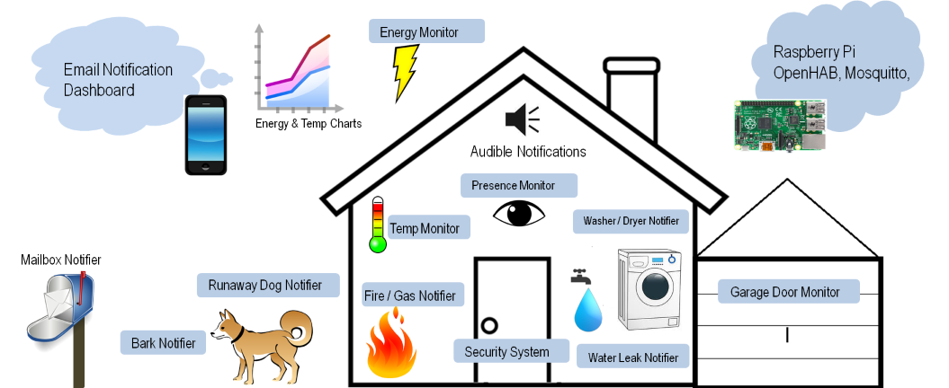
OpenHAB Example

Slide 19
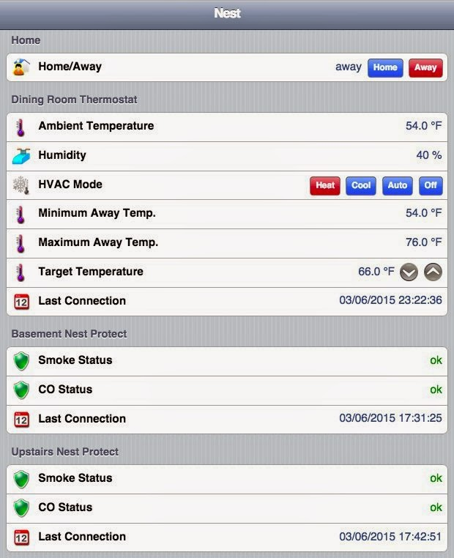

Slide 20
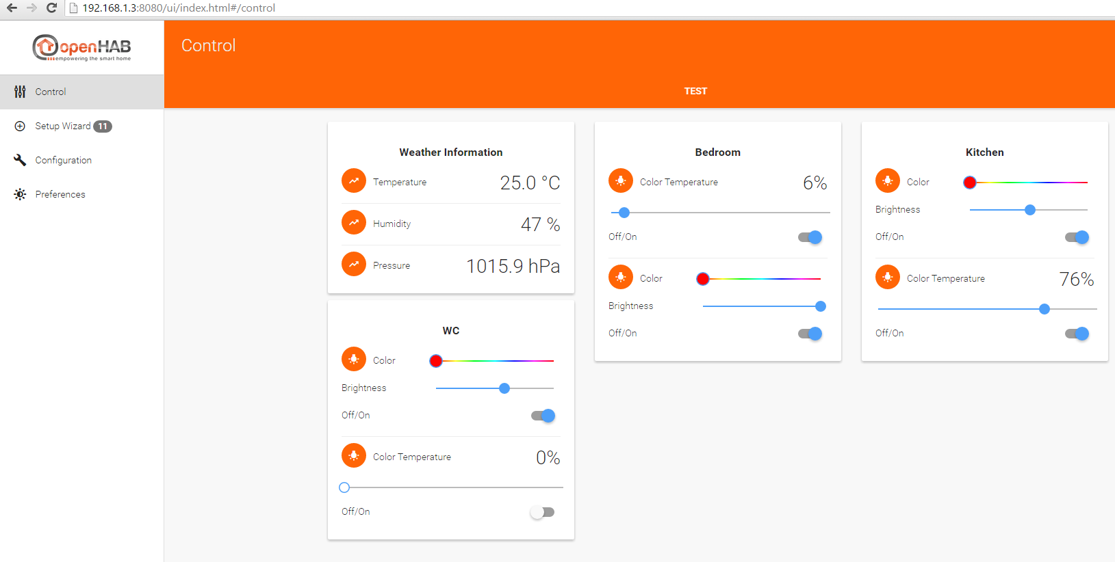
OpenHAB Paper UI
Auto discovery supported

Slide 21
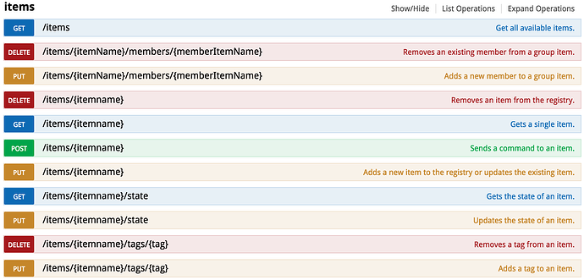
OpenHAB REST APIs

Slide 22
Configuration
Items
/* Sensors */
String Serial_Port1 "Serial Port 1 In [%s]" {serial="COM3@9600"}
Switch Serial_Port1_Out <light>
/* Lights
Dimmer Light_FF_Living_Table "Table" (SF_Living, Lights)
Switch Light_FF_Kitchen_Ceiling "Ceiling" (SF_Kitchen, Lights)
Sitemap
Text item = Light_FF_Living_Table
Text item = Light_FF_Kitchen_Ceiling
Text item = Serial_Port1_Out
Rule
rule "Serial Port 1 ON"
when
Item Serial_Port1_Out changed from OFF to ON
then
sendCommand (Serial_Port1, "1")
end

Slide 23
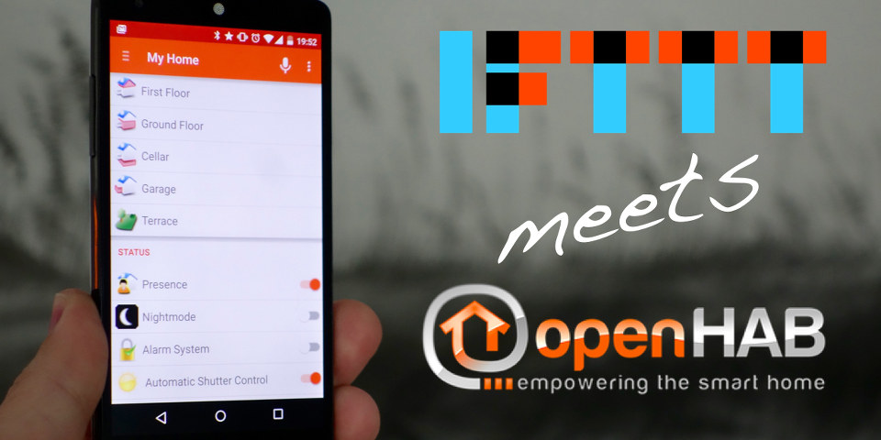
OpenHAB Interoperability

Slide 24
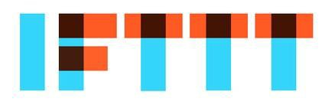
If This, Then That
IFTTT
homepage
http://ifttt.com

Slide 25
CREATE AUTOMATED
PROCESSES
BETWEEN
VARIOUS APPS

Slide 26
ALLOWS CERTAIN
TRIGGERS TO HAPPEN
AND CAUSE AN ACTION
IN ANOTHER APP

Slide 27
Integrate with the applications you love:
Without writing a code.
Without hiring a developer.
And without spending thousands of dollars.

Slide 28
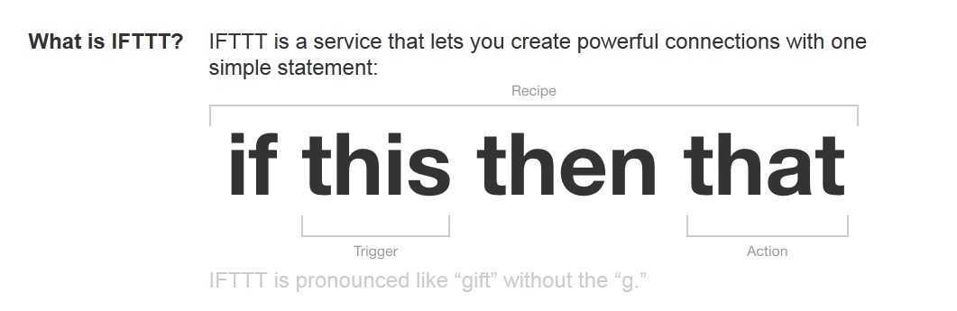
IFTTT
Allows you to easily connect Internet services with your own custom logic
Connects all kinds of services with a few mouse and key strokes.
Provides two types of service: IFTTT and DO
FREE
Applet

Slide 29
IFTTT Works by connecting Channels
Channels are Internet services that you interact with
Facebook, Dropbox, Weather, New York Times, Ebay, Amazon, Craigslist, Messaging, Email, Yahoo, Google, Evernote
Home automation devices: Nest, ecobee, OpenHAB
Alarm systems
Many smartphone apps
Clock, calendar, schedule
over 200s
IFTTT acts as a connection between these channels, making them work together so you work less.

Slide 30
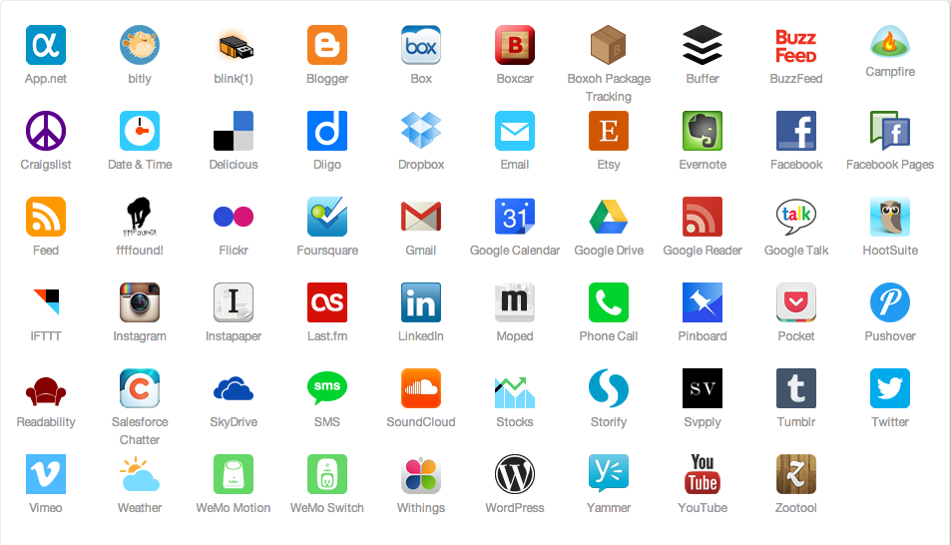
Super Useful IFTTT Channels

Slide 31
Channels are connected by Applets
Applets are composed of Triggers and Actions
Triggers are events
Selecting a channel is the 1st step of creating an applet
each channel can initiate various events
Selecting a specific event is 2nd step of applet
E.g., an email whose subject containing specific keyword or specific sender

Slide 32
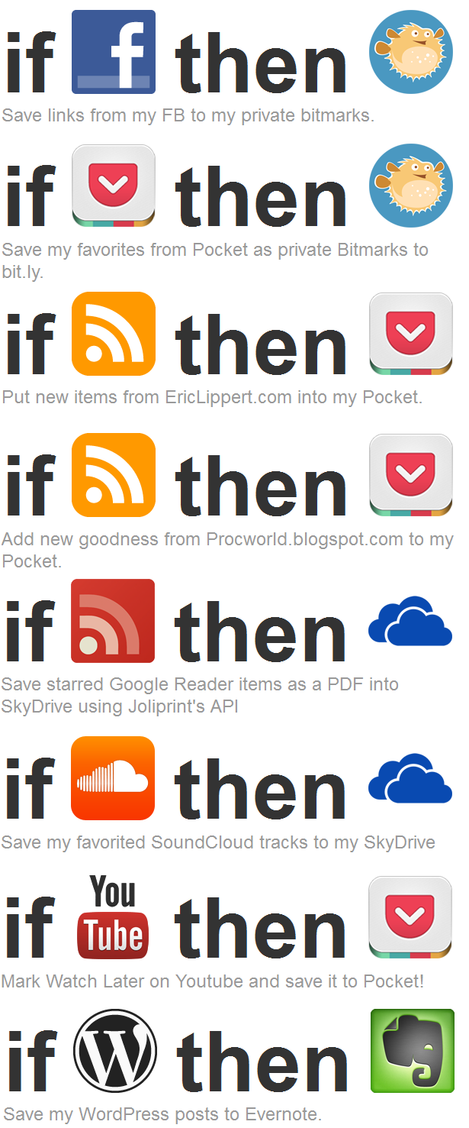
Actions
An action is what should be done upon occurring a triggering event (in an applet)
Examples
turning a light on
Changing a thermostat mode

Slide 33
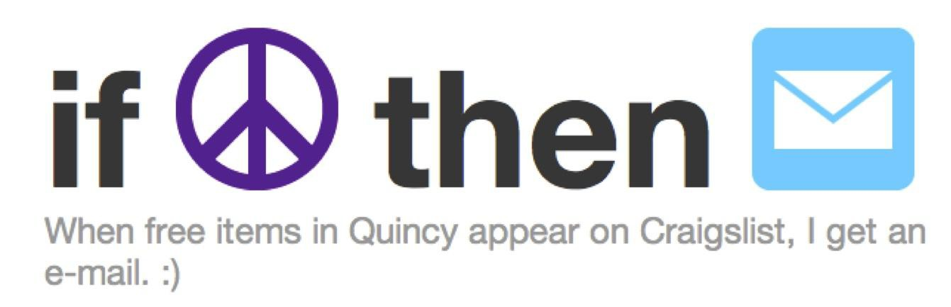
Channels are connected by Applets that you create
An applet looks like this.
"This" is free items on Craigslist in Quincy.
"That" is send me an e-mail.
You can create your own applets using different channels, or
you can browse applets that other people have shared and adapt them for your own use.

Slide 34
Examples of IFTTT Applets (Zapier Zaps)
Applets describe what to do on a specific event
1000s of applets (created and shared by users) available
Send me message if my front door opens.
Turn on alarm if I leave home
If my daughter arrives/leaves at/from school, send me notification
Send me Android notification if humidity in my house increases above set-value.
When all members of household leave, set A/C to away mode.
If rain is forecast tomorrow, turn off sprinkler.
If the traffic is bad, wake me up early.
turn on security light at the always exact sunset time
The potential uses for IFTTT are endless.

Slide 35


IFTTT Smartphone App
Smartphone notification
Receiving notifications of selected activities of applets
Create, Modify, Enable/Disable Applets
DO app
One touch shortcut
To control something
Home automation, alarm, light, etc.

Slide 36
Code Development Services
Temboo – automatic code generator
It also provides platform service (data processing)

Slide 37
Temboo Code Development Service (it’s a code generator)
Help users to automatically create IoT device code by simple configurations and minimal inputs
all the time-consuming logic has been figured out and built in
like how to access APIs
Help users to integrate various Internet services on their IoT devices and allow generating application code (program) with easy step-by-step configurations
Temboo—Overview
https://www.youtube.com/watch?v=5OZgrw7l_10

Slide 38
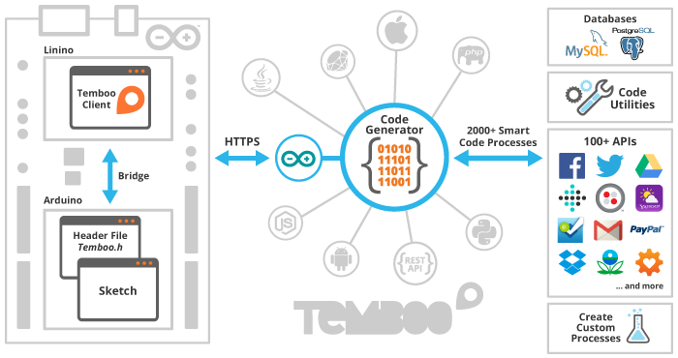
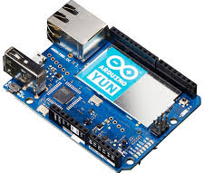
Temboo

Slide 39





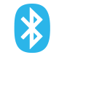

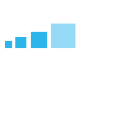

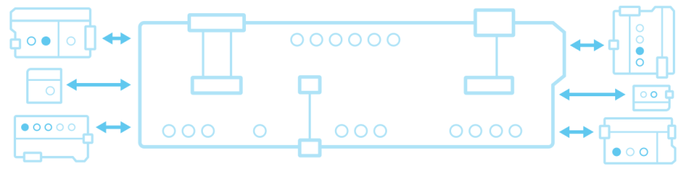
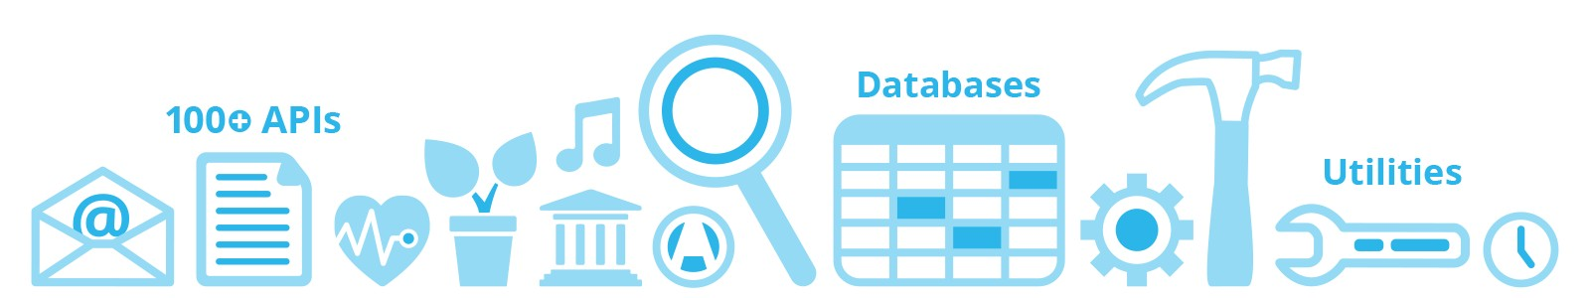
Temboo
devices
analysis/visualization
Texas Instruments
Arduino
Samsung
Microsoft Power BI
Google BigQuery
communication methods
Blueooth
Ethernet
GSM
WiFi
data transport protocols
MQTT
CoAP
HTTP
internet services
Notes:
HARDWARE
Temboo comes prepackaged and fully integrated into the IDEs and hardware of powerful development platforms. Start programming your embedded devices with Temboo in minutes.
CONNECTIVITY
However your device connects to the Internet, it can run applications built on Temboo. Follow our streamlined steps to get your hardware online.
DATA STREAMING
It's your data, and we'll let you store it where you choose. You can wire sensors to the cloud easily and update where your data goes, even while your app is running.
CHOREOS
Make your devices interact with hundreds of APIs, databases, and code utilities with our cloud-based Choreo processes. Explore thousands of Choreographies in our Library and the many tasks they take care of.
M2M
Program multiple devices to communicate with each other and the Temboo platform using common machine-to-machine messaging protocols.

Slide 40
Temboo - Target web services
called Choreos (like drawing canvas)
Amazon (various)
Google services (e.g., emails, geocoding, storage)
Dropbox, Box
eBay, Paypal
Facebook, Fedex, Github, Instagram,
NYTimes (news, stock), Tumbler, Uber,
Yahoo (finance, weather), Youtube

Slide 41
Supported Temboo SDKs
SDKs provide language-specific wrappers for all the bundles in the Choreo Library.
ANDROID SDK
ARDUINO
C# SDK
iOS SDK
JAVA SDK
NODE.JS SDK
PHP SDK
PROCESSING SDK
PYTHON SDK
RUBY SDK
Notes:
Our SDKs provide language-specific wrappers for all the bundles in the Choreo Library. This allows you to integrate Choreos into the applications you build using the programming language and IDE of your choice. It also lets you combine Choreos that access different APIs into a seamless workflow.
Don't see your language here? Don't fret. We're working on more languages at this very moment. Stay tuned, and feel free to suggest a language here. If you fancy yourself an adventurer, you're also welcome to check out the REST API directly (cURL code snippets are available for all Choreos in the Library).

Slide 42
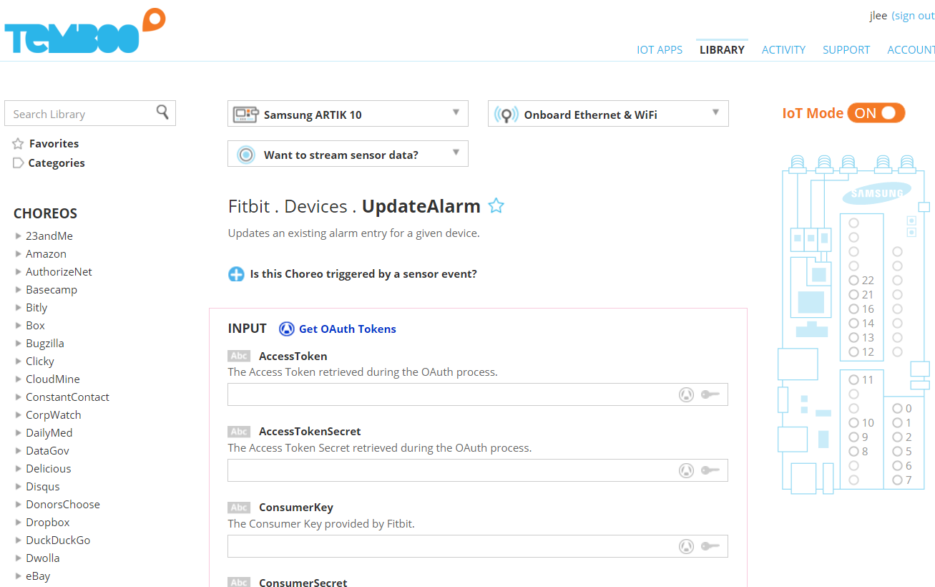
Temboo Choreos

Slide 43


Slide 44
create IoT solutions without custom coding
supports MQTT, JSON, AMQP, XMPP, Stomp, JMS, and WebSockets, while providing published APIs
Fault tolerant, scalable, and cost efficient
manage very large numbers of devices and event cycles
provides interfaces for customized event triggering, searching, and analytics
Devices can be assigned to physical or logical assets via pluggable, commercial, off-the-shelf modules.
Bidirectional and asynchronous communication
Event data can be stored in the cloud or on local servers
Out-of-the-box support for rapidly integrating customized device data into other platforms.
Notes:
create IoT solutions without custom coding.
Devices can be assigned to physical or logical assets via pluggable, commercial, off-the-shelf modules.
SiteWhere supports numerous protocols, such as MQTT, JSON, AMQP, XMPP, Stomp, JMS, and WebSockets, while providing published APIs.
Event data can be stored in the cloud or on local servers.
The solution is fault tolerant, scalable, and cost efficient.
Communication with devices is bidirectional and asynchronous. This allows SiteWhere to manage solutions that require very large numbers of devices and event cycles.
SiteWhere provides interfaces for customized event triggering, searching, and analytics, as well as out-of-the-box support for rapidly integrating customized device data into other platforms.

Slide 45
SiteWhere - Complete Device Management Solution -
Add devices through self registration, REST services, or in batches
Control large numbers of devices using batch command operations
Use advanced command framework to interact with devices
Avoid per-device charges of SaaS vendors
Associate devices to assets in your asset management platform
Associate devices to locations for geospatial features

Slide 46
SiteWhere - Largely Scalable Event Solution -
Provides massively scalable device event management solution
Offers highly tuned MongoDB and HBase implementations
Provides time series database for device events
Runs on a laptop or scales linearly in a clustered environment

Slide 47
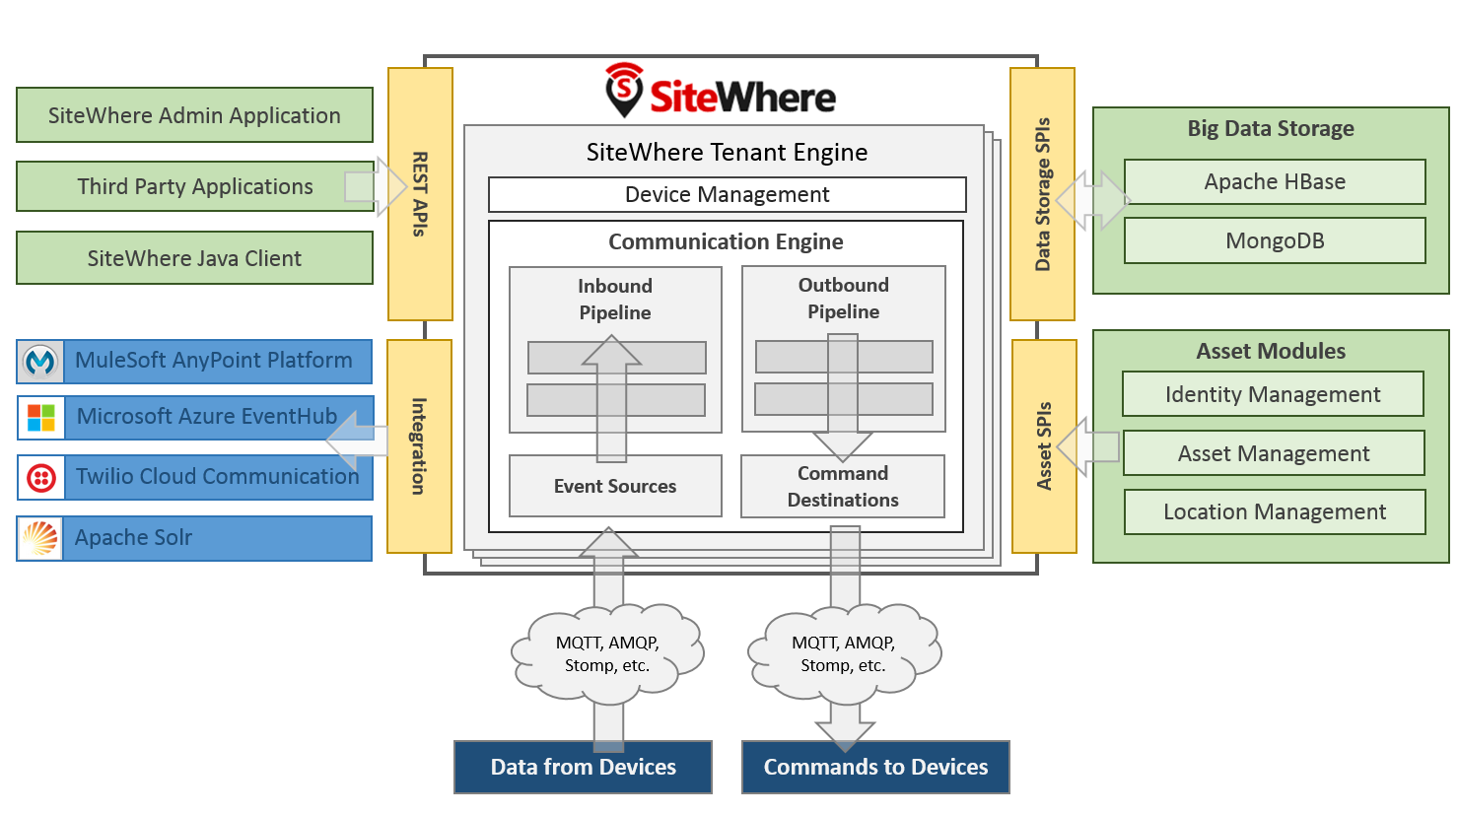
SiteWhere Architecture
Notes:
Service Provider Interfaces (SPIs) for the data operations

Slide 48
Multi-Tenant System
Each tenant has a separate processing pipeline
Run multiple IoT applications on a single SiteWhere instance
Offers separate data storage per tenant with no intermingling
Offers separate customizable processing engine per tenant
Start, stop, and reconfigure tenants without affecting others

Slide 49
Tenant Components
Tenant Engines
Tenant Datastore
Device Communication Engine
interacting with devices
Registration of new or existing devices
Receipt of events from connected devices
Delivery of commands to connected devices

Slide 50
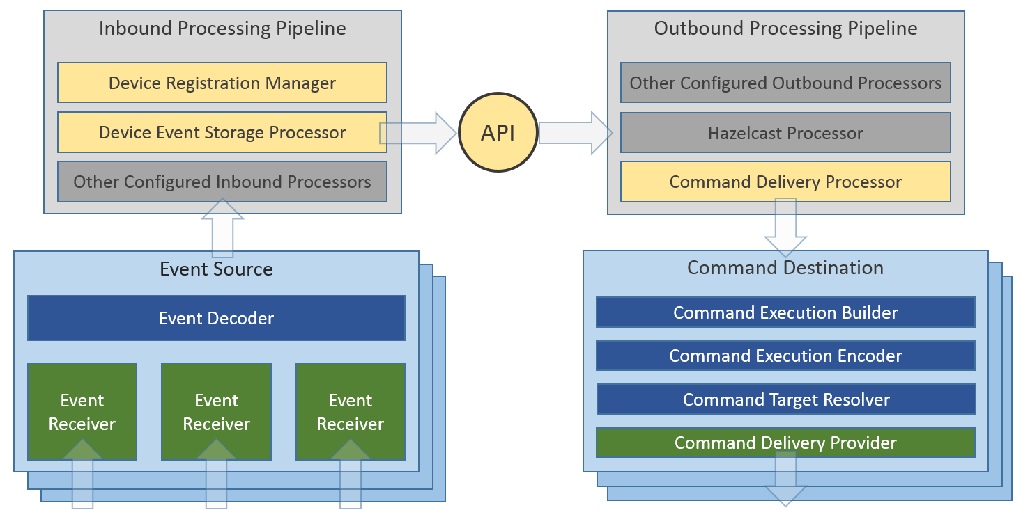
SiteWhere - Device Communication Engine -
Notes:
Hazelcast to interactively broadcast event data to other interested systems.

Slide 51
Asset Modules
Assets represent objects in the physical world – people, places, and things.
Device specification assets
used to describe the hardware information/configuration for a type of device
Device assignment assets
used to describe an entity associated with a device

Slide 52
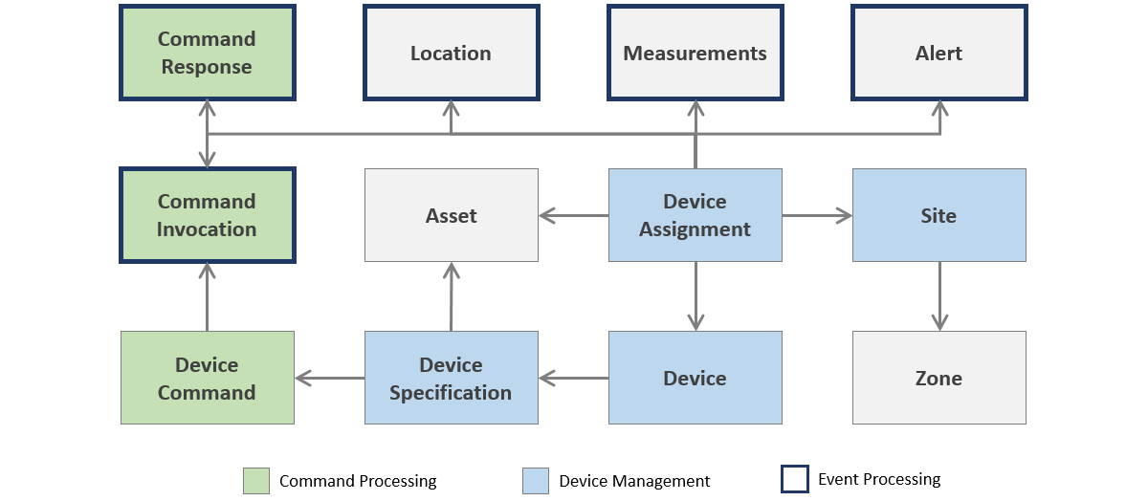
Comprehensive Object Model Core objects
Notes:
It captures the relationships between all of the various concepts in tracking device data.
Sites are used to organize devices that are related (e.g., location-aware) so that their events can be grouped.
Zones for securely separates devices and regions.
Each device has a unique hardware id.

Slide 53
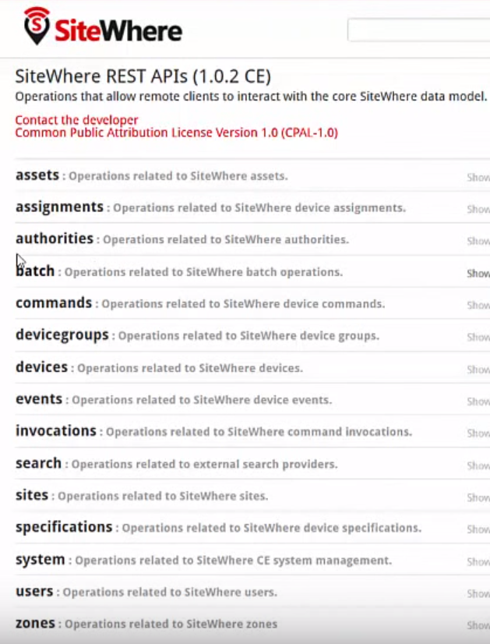
REST APIs for All Entities

Slide 54
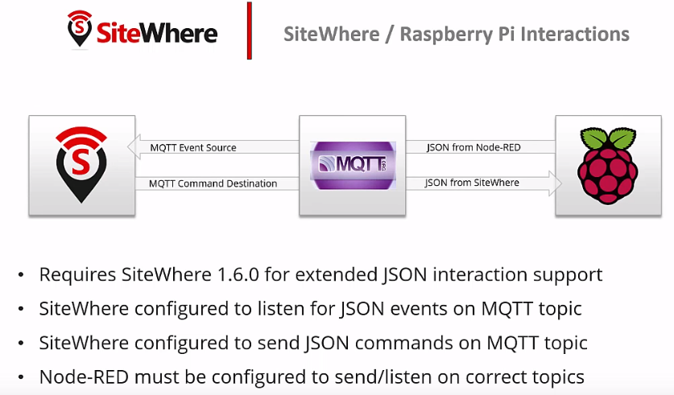
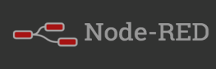
SiteWhere Node-RED plug-in
SiteWhere Node-RED Integration
https://www.npmjs.com/package/node-red-contrib-sitewhere
Notes:
https://www.youtube.com/watch?v=gD1_6JCWwHU&spfreload=1#t=22.401481

Slide 55
Node-RED Developed by IBM, Open Source
IoT Lecture Series
Prof. John Lee
IUPUI & KAIST

Slide 56
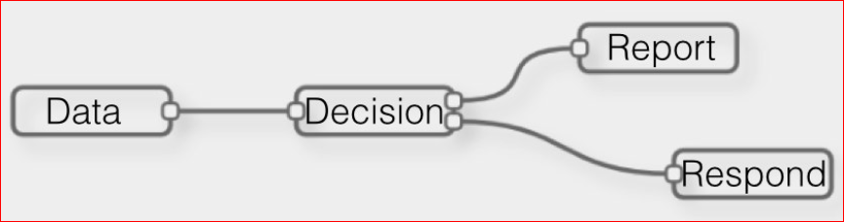
What is Node-RED?
A visual programming tool for wiring the IoT
Application server (can run on anywhere; e.g., RPi, PC, Cloud)

Slide 57
Node-RED
Node.js-based visual rapid prototyping tool for wiring the IoT
what is Node.js?
JavaScript framework, which makes it easy to implement JS-based web-server
Can run on your device, PC, or cloud
Comes with a large library
transform, network, social, hardware, storage, analysis
Flows (node-RED projects) can be shared as JSON strings, make it easy sharing
http://flows.nodered.org
Developed by IBM
http://www.slideshare.net/BorisAdryan/boris-adryan
Notes:
modified

Slide 58
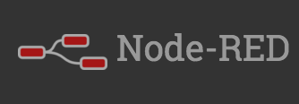


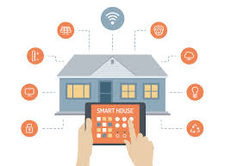



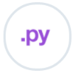


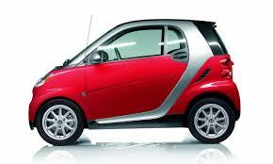

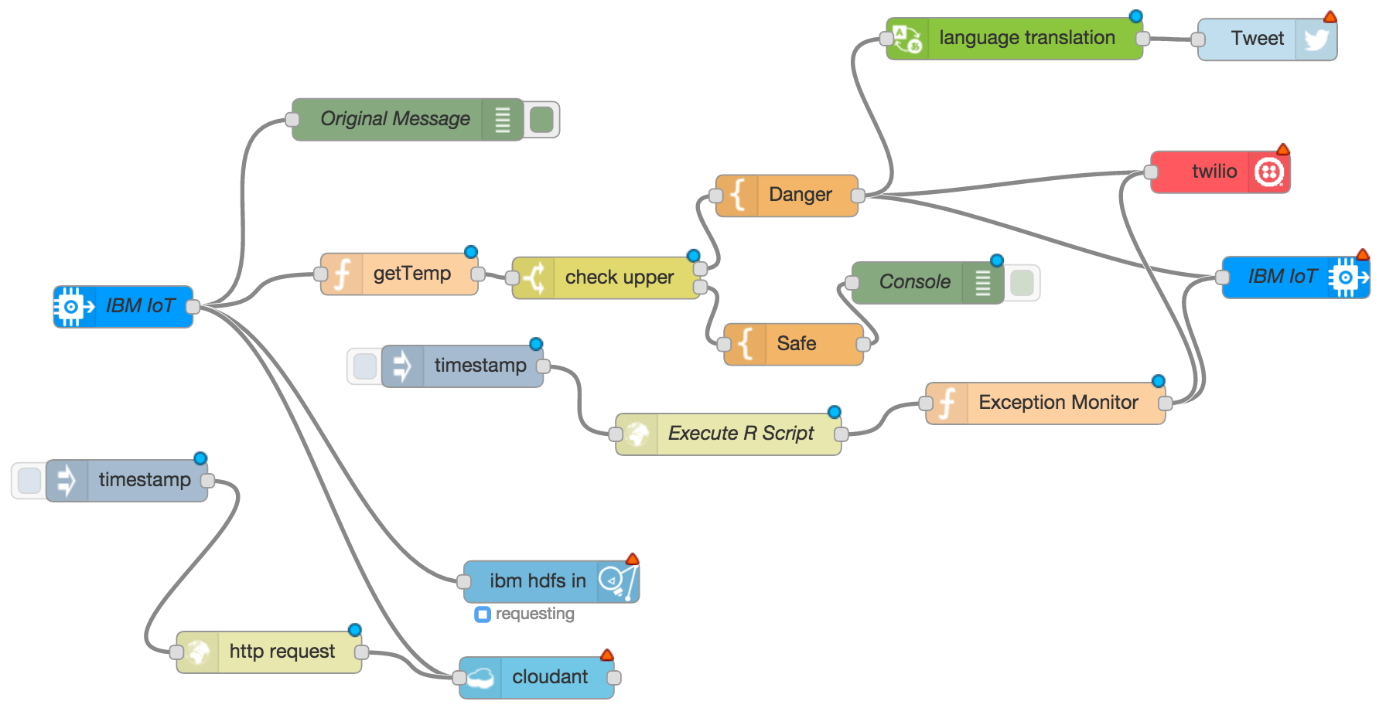
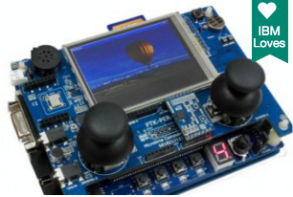
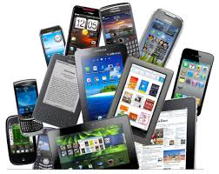
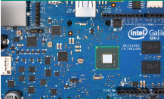
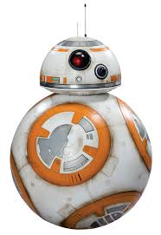
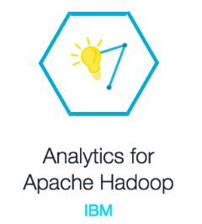

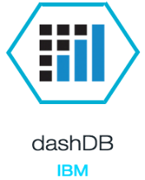

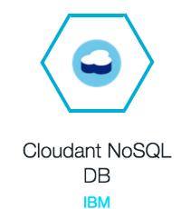

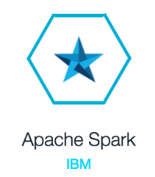
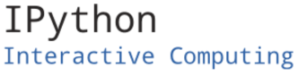

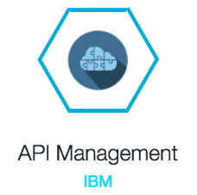
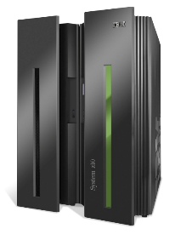


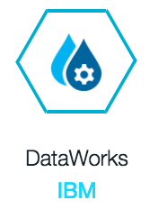
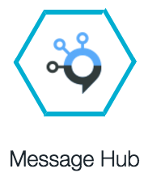
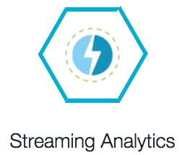
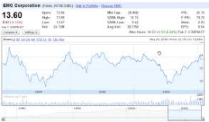
visual wiring tool for
the Internet of Things
SMS
IOT Gateway
(Sensor)
IOT Gateway
(Control)
Open Data
other tools for interconnect
58
Enterprise System

Slide 59
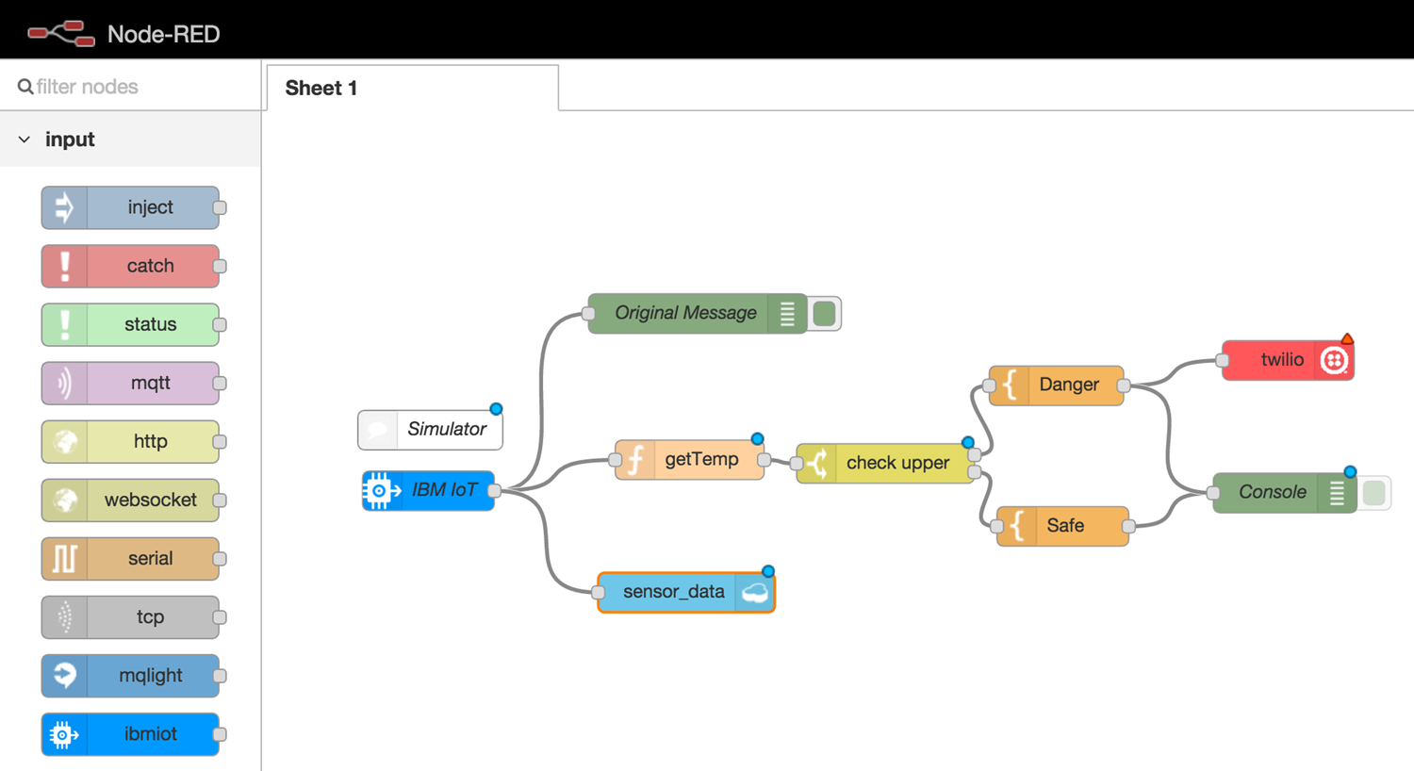
High Temperature Warning Diagram

Slide 60

Home Automation

Slide 61

Node-RED Workspace

Slide 62

Node-RED Nodes

Slide 63


Create a First Flow
Add an inject node and a debug node, and inject timestamps
Notes:
modified

Slide 64

Create a First Flow
Place a function node between inject and debug, and wire

Slide 65

Create a First Flow
Create a function to convert timestamp to date format
JavaScript coding
Notes:
modified

Slide 66


Create a First Flow
Deploy
Press inject node again
Timestamps
(milli-seconds since 1970.1.1)
Notes:
modified

Slide 67
Connecting Node-RED and Raspberry Pi GPIO
After installing Node-RED on Raspberry Pi,
There are two main ways of interacting with a Raspberry Pi using Node-RED
rpi-gpio nodes
provided in the palette for monitoring and controlling the GPIO pins. This is the simplest and recommended way.
wiring-pi module
this provides complete access to the GPIO pins, and other devices, within Function nodes.
Notes:
modified

Slide 68



Output Interface
Digital Output node
Notes:
modified

Slide 69


Create Flow for Digital Out
Add inject, debug nodes and change parameter of the inject node, by double clicking it
Notes:
modif

Slide 70

Create Flow for Digital Out
Change Repeat field into “interval” for every 1 second.
Set Name to “tick every 1 sec”
Change
Notes:
modi

Slide 71


Create Flow for Digital Out
Add a function node and double click to edit function.
•
Set function node name
For every invocation, toggle the value, and output
Notes:
modi

Slide 72


Create Flow for Digital Out
Add an rpi-gpio node (from part “Raspberry Pi”) and double click to change pin number.
Set Pin 16
Digital Output Mode
Notes:
mod

Slide 73


Create Flow for Digital Out
Wire nodes and click deploy

Slide 74
Temperature to Tinamous to Plot Graph

Slide 75
Node-RED Tutorial
https://www.youtube.com/watch?v=nHQl-Pb1Zvw 17:00
http://randomnerdtutorials.com/getting-started-with-node-red-on-raspberry-pi/

Slide 76

Node-red-dashboard

Slide 77

Notes:
http://blog.dragansr.com/2015/08/visual-iot.html

Slide 78


Slide 79

Dashboard Nodes

Slide 80
AT&T IoT Platform
IoT Lecture Series
Prof. John Lee
IUPUI & KAIST

Slide 81






Up and running fast
Sign up for a free developer account
1
Create a Data Stream
3
Create a new Device inside M2X
Download a Client Library for
your device
2
4
5
Receive data from devices

Slide 82











Client Libraries
Piece of code used to connect to AT&T cloud
Find Supported Libraries:
m2x.att.com/developer/client-libraries
Notes:
modif

Slide 83
What is AT&T IoT Platform?
IoT PaaS (platform as a service)
Cloud IoT development and operating platform
Used to create streams and triggers
Flow IDE
Node-RED-based IDE for service connection and data processing logic development and deployment
M2X data store
Notes:
mod

Slide 84
AT&T IoT Platform – Flow IDE
https://flow.att.com/start
A fully hosted, Node-RED-based visual programming environment with ability to maintain versioning, publish, and run solution on AT&T IoT PaaS.
'Do something' with the data, create an application that is ready for end users to consume
It offers nodes that are preconfigured to allow easy access to multiple data sources, cloud services, device profiles, and communication methods.
Notes:
modi

Slide 85

AT&T IoT Flow IDE - Overview

Slide 86




AT&T IoT Flow IDE
Process flow and prototyping
AT&T Flow
Visualization and
Design tools
Open standards
Security
Service delivery and integration
Notes:
mod

Slide 87




Up and running Flow fast
1
Sign up for a free developer account
3
Pick Nodes and Code your app
Create a new Flow
2
Deploy your flow to Sandbox for testing
4

Slide 88











The Kit
Developer data plan
Extensible developer board
LTE module
Developer tools
Integrated with cloud platforms

Slide 89
M2X data store
Stores the data from all devices
may initiate triggers on pre-designated thresholds

Slide 90

IoT Application Development Platform
IoT Lecture Series
Prof. John Lee
IUPUI & KAIST

Slide 91

http://www.thingworx.com
A complete software solution designed to build and run the IoT applications of the connected world 10X faster.
To largely reduce the time, cost, and risk required to build innovative IoT applications.
Main components
ThingWorx Composer: Application Modeling Environment
Codeless "Drag and Drop" Mashup (webpage) Builder
Event-Driven Execution and 3D Storage
Notes:
For industry

Slide 92




































Challenge: Building Your IoT Business on the Right IoT Platform
Applications
Cloud Services
Business Systems
Application Enablement
?
Wireless Provisioning
Communications
Elements
Internet
Device
Clouds
Mobile
Networks
The Network
4
Sensors,
Devices
&
Equipment

Slide 93





















Conventional Application Development is Unable to Unlock the Vast Potential of Smart Connected Products
Not designed to work with the unique and evolving requirements of IoT apps
Fixed Applications
Complex Programming
DESIGN AND BUILD INTERFACE
Difficult to Maintain & Evolve
DEVELOP EVENT TRAPS AND QUERIES
MANAGE CHANGE
Application Development
DEVELOP DATA RELATIONSHIPS
INTEGRATE OR WRITE SERVICES
ARCHITECT THE DATA MODEL
High Risk & High Cost
Communications Elements
COMMUNICATIONS
Internet
Mobile Networks
Barrier to
The Network
Sensors, Devices
& Equipment
Innovation
Notes:
modi

Slide 94


Challenge: Building Your IoT Business on the Right IoT Platform
Applications
Easier Programming
Cloud Services
Business Systems
Easier to Maintain & Evolve
Application Enablement
?
Build and Deploy
IoT Applications
Wireless Provisioning
Lower Risk & Cost
Communications
Elements
10X Faster
Internet
Device
Clouds
Mobile
Networks
The Network
Fast to Innovation
4
Sensors,
Devices
&
Equipment

Slide 95
















Ways to Remove Application Bottlenecks
Ubiquitous Connectivity: integrates with your things and systems
Storage
Model-Based Development: model instead of code, create 10x faster; provides scalability;
can handle multitude of devices easily
Things
Relationships
Codeless Mashup Builder: drag & drop configuration, flexible deployment
Search-based Intelligence: put device data and tribal knowledge at your fingertips
Notes:
ThingWorx offers four ways to remove this bottleneck:
Accept that there will be many different ways to connect intelligent things, and work with them all
Don’t code, model – not only can you build your application up to 10x faster initially, but you have even greater savings as you evolve and expand
Configure with drag-n-drop ease using the newest internet standards, and flexibly deploy in a cloud or behind your firewall
Build Intelligence into, not on top of your application – making every thing, person, transaction and conversation searchable in natural language

Slide 96



























ThingWorx Platform architecture overview
Applications Layer:
Application provided by ThingWorx is a web-based portal displayable on any type of screen (Tablets, PC, Smartphones). The portable is reachable through any web browser
Business Systems
Easy & fast programming
Cloud Services
Core Layer - application enablement:
Contains the asset database and all the business logic. Also contains codeless development platform to modelize assets and build business logics using predefined libraries
Easy to maintain & evolve
Fast prototyping reduce costs & risks
Communication Layer - elements:
Wireless Provisioning
Promote innovation
Sensors, Devices, and Equipment are connected through various methods, through different device clouds, & through hybrid networks environments
Internet
Device Clouds
Mobile Networks
Device management & connectivity
The Network
Connectivity Layer - sensors, devices & equipment:
Contains the connectors to any type of systems or SI through any type of network (IP, GSM, RF…)
Easy to connect things through Edge Micro Server (EMS)
Notes:
modi

Slide 97










ThingWorx IoT Platform Technology Simplifies Solution Delivery
Rapid Application Development Environment
Platform and tools to enable the rapid development of innovative IoT apps that unlock new value.
Build
Device and Data Management
Solutions to securely collect and process machine and sensor data, and to remotely
monitor, manage, service and control wired and wireless intelligent assets
Manage
IoT Connectivity Middleware
Software to securely connect devices and communicate machine and sensor data
into the cloud
Connect
6

Slide 98
























Purpose Built for IoT Development
Dynamic Applications
CLOUD SERVICES
MASHUP BUILDER
SQUEAL
Search
External System
& Services
Application Enablement
REST APIs + Security
REST APIs
BUSINESS ENTERPRISE SYSTEMS
SYSTEM SERVICE INTEGRATION
3D STORAGE ENGINE
BUSINESS LOGIC
COMMUNICATIONS
Communications Elements
Internet
Mobile Networks
BIG DATA ANALYTICS
The Network
Sensors, Devices & Equipment
10

Slide 99

The ThingWorx Stack
• Test1
• Test2

Slide 100



The unique platform characteristics are
Ubiquitous Device Connectivity Layer
ThingWorx provides scalable, secure, embeddable, and easily deployable communications designed for connecting sensors, devices and equipment across any network topology and an communication scenario
Model-based Development Reduces Time/Cost by 10X
ThingWorx “codeless” development enables you to model the Services, Storage, Events, Collaboration, and Relationships for the Things in your world. This results in high levels of efficiency and reuse, increasing development velocity by 5X – 10X.
Event Driven Execution & 3D Storage Engine
Event-driven execution supports scale requirements for massive numbers of devices. Optimized & unified storage for time-series, structured, and social data 10X Faster than traditional RDB. Two-way interfacing with big data analytics.
Notes:
So how do you build apps fast?
With the right tools
Model-based Composer
Codeless Mashup Builder
Flexible Device Connectivity and deployment options

Slide 101



The unique platform characteristics are
Mashup Builder: Rapid Creation of Collaborative Workspaces
ThingWorx’s “drag and drop” Mashup Builder enables developers and business users to rapidly create collaborative applications, mobile UI, analytics, and search-based BI, helping solve problems and capture opportunities faster
SQUEAL: Search-based Intelligence Unlocks Collective Wisdom
ThingWorx SQUEAL™ (Search, Query & Analysis) brings Search to the operational intelligence world, enabling every user to “search the information and Things in their world”
Flexible Deployment Options
Deploy to meet the needs of the market – Cloud Scale, On-Premise and Embedded options meet the needs of every use case
Notes:
So how do you build apps fast?
With the right tools
Model-based Composer
BI: builder interface(?)
Codeless Mashup Builder
Flexible Device Connectivity and deployment options

Slide 102
What Can ThingWorx Do For You?
Provide a compelling web interface for your device
Graph data for analysis
Configure your device
Share your data as a web
Integrate your device with external resources
Collect and store data from your device
Provide a data modeling and development environment
Collect acquired data for future use
Monitor and alert you when conditions occur
Manage multiple devices
Simplify communications between you and your device
Real time communications from your device to the server
Fast, firewall friendly and encrypted connections

Slide 103


Building Rich Clients
Web Applications without HTML
Data Modeling & High Performance Storage without SQL
External Integrations
Rich Library of Widgets
Browser Based Development
User Authentication and Security Built In

Slide 104
Applications
Smart Grid Layers
Connected Sensors & Devices
Connected Products
Connected Industries
Application Sectors
Manufacturing
Oil & Gas
Smart Grid / Energy
Smart Cities - Infrastructure / Utilities
Smart Cities - Smart Buildings
Machine To Machine (M2M)
Complex Machinery
Medical Devices
Transportation
Education & Public Services

Slide 105

Manufacturing
Automated Plants, Production Line Dashboards and Controlling Apps, Inventory Monitoring
Notes:
ThingWorks – Manufacturing Example
Automated Plants
Production Line Dashboards and Controlling Apps
Inventory Monitoring

Slide 106

ThingWorks - Smart Buildings
Environmental Sensors
Heating, Ventilation and Air Conditioning (HVAC)
Office & Safety Equipment

Slide 107

ThingWorx - Machine2Machine
Connect
activities
services
inter-relationships
of all
people
systems
devices
in the network.

Slide 108

ThingWorkx - Complex Machinery
Real-time condition-based maintenance
Benchmarking
Collaborative technical support services

Slide 109

ThingWorkx - Transportation
Vehicle automation
Smart transportation
Smart delivery of goods
Reduce energy comsumption
Maximize corporate and tax payer ROI

Slide 110

Smart Traffic Monitoring & Public Safety
All Traffic Solutions is the leader in radar speed displays and variable message signs designed to improve traffic safety outcomes.
Business Challenge
Solution
Results
Increased customer demand for new features and an overall increase in application sophistication.
Provide more comprehensive
business system integration
Need to offer advanced data mining for customers requesting predictive analytics for traffic control
SmartApps web-based traffic control suite.
All Traffic’s SmartApps solution suite allows law enforcement professionals, as well as state and local agencies, to remotely monitor, manage, and interact with traffic safety signs using a web-based application and virtual map.
With ThingWorx, All Traffic is able to rapidly develop mobile interfaces using the ThingWorx Mashup Builder, provide more comprehensive business system integration, and offer advanced data mining for customers requesting predictive analytics for traffic control.
Faster time to market
Rapid development of mobile
user interfaces
Advanced data mining that All Traffic can now offer its customers
Improved scalability over previous technology, allowing All Traffic to extend their solution and deliver new services to customers in ways that were previously impossible.
"ThingWorx's rapid application development environment and scalable platform allow us to extend our solution and deliver new
services to our customers in ways that were previously impossible.”
- Scott Johnson, CEO, All Traffic Solutions

Slide 111

Smart Agriculture
OnFarm is a highly specialized integrator of agriculture field asset
and information systems for the farming industry.
Business Challenge
Solution
Results
As technology adoption in agriculture has grown, growers have been forced to manage information from several unrelated systems.
OnFarm sensed an opportunity to deliver a SaaS offering to growers that provides for smart decisions in farm management and production.
Goal was to get to market quickly with an integrated offering, and needed a technology platform that would scale as their business grew over time.
OnFarm utilizes the ThingWorx technology platform to take on the challenge of integrating information across multiple unrelated companies.
The OnFarm solution combines real-time sensor data from soil moisture, weather, pesticide usage, alerts and notices, and growing conditions from farming sites into a consolidated web-based dashboard designed specifically for growers. Growers can also take advantage of advanced imaging and GIS mapping information to spot crop issues and visualize where farming assets are located.
OnFarm’s customers experience a 10% improvement in water usage, reduced fertilizer usage,
avoid crop stress, and can now determine ideal crop locations based on sensor data.
"Using ThingWorx enabled us to get to market at least a year faster than otherwise possible and with functionality that far exceeded what would have been possible otherwise. Because we choose ThingWorx we were able to focus on developing functionality that provided significant advantages, essentially redefining the market.” - Lance Donny, CEO, OnFarm Systems

Slide 112

Smart Agriculture
Dirt Road Data is a highly specialized supplier of distributed automation systems for the energy, agriculture, and water management markets.
Business Challenge
Solution
Results
Smart flock management, production, and financial results are critical aspects of the farming industry.
Previously, capturing key operational farming data was a manual and time-consuming process.
This resulted in lack of operational insight, poor performance, lower financial results, and inefficient farm management.
Verif-Eye™ - The first cloud-based solution
for remote farming command and control.
Dirt Road Data’s Verif-Eye product line utilizes the ThingWorx technology platform to power its cloud-based solution for smart poultry farming, providing an end-to-end application to wirelessly collect, store, and visualize critical poultry operational data, including bird counts, egg metrics, and feed usage
Enables farmers to analyze real- time metrics, helping them drive smarter decisions in farm management and production.
"We are pleased to be working with ThingWorx to deliver the first-of-its-kind application for smart agriculture," stated Daniel Goss, President of Dirt Road Data. "Poultry farmers are concerned about protecting their flock and managing their performance. Our solution, powered by ThingWorx, provides these farmers with a comprehensive online dashboard of their farms, giving them the ability to analyze data and key performance indicators from flock to flock, and allowing them to readily spot trends and act on the information to increase their feed conversion rates, and productivity."

Slide 113

Water Monitoring
Aquamatix is a software and services company providing specialist integration of real-time systems and data for water and wastewater operations and asset management.
Business Challenge
Solution
Results
Lack of monitoring and control system for domestic water and sewage service providers.
Limited alarming and notifications
of real-time conditions.
Cloud-based WaterWorX™ software, a real- time solution that integrates operational and fixed asset data.
WaterWorx includes an SMS and voice alarm facility for out-of-hours alerts, creating a virtual control center.
Faster time to market
Reduced development costs for
software company Aquamatix
Lower technology investment
Continuous, incremental value through new applications for Aquamatix customers which include Veolia
"WaterWorX, powered by ThingWorx, delivers real-time performance and improves efficiency of water assets.”
- Laurie Reynolds, Managing Director, Aquamatix

Slide 114

Structural Monitoring
Smart Structures is a global leader in wireless solutions for smart
infrastructure monitoring, delivering solutions to improve the quality of bridge pilings, foundations, and other concrete structures, while reducing construction costs and improving safety.
Business Challenge
Solution
Results
With their current technology, Smart Structures hit the wall on the value curve and need to upgrade to
a more scalable robust platform to deliver the next generation of their service offering.
Smart Structures SmartPile® Embedded Data Collector (EDC) technology uses software to process data from wireless embedded sensors embedded within
concrete piles used in foundations. The ThingWorx platform provides the critical software and AlwaysOn communications infrastructure for the SmartPile system, allowing Smart Structures to securely connect its remote workstations to a centralized, cloud-based information database and Internet portal where sensor data is stored.
Faster Time-to-Market for cloud- based information database and Internet portal
Rapid scaling
Allows their customers to be better prepared to react and respond to deficiencies in strength and integrity while minimizing costs and risk.
"We chose ThingWorx because we were able to extend our current on-line system dramatically faster than with previous generation tools. These new technologies are changing the way we interact with our physical world, and by allowing objects and machines to send us data about their performance, our customers will be better prepared to react and respond to deficiencies in strength and integrity while minimizing costs and risk."
– Tom Chiarella, CEO, Smart Structures

Slide 115

Connected Vehicles
Our client is one of the world’s largest providers of wireless network equipment, and operates telecommunications networks, television and video systems, and related services.
Business Challenge
Solution
Results
Challenge of getting to market quickly with an integrated solution and online application that integrates real-time sensor data
from on-board vehicle telematics into a unified and interactive user interface that is mobile-friendly
Connected Vehicle Cloud - Delivers significant opportunity for stakeholders in the automotive ecosystem to reach drivers and passengers in new ways.
Rapid time-to-market
Ease of building mobile-friendly user interfaces
Ease of integration
Enabling innovative new applications and services for multiple different consumers

Slide 116









































Unites the Connected World
People
Cloud Services
Business Services
Things
IoT Device Clouds
M2M Device Clouds
Notes:
Finally leverage the power of our diverse IoT eco-system…
…Creating Value
…Through Applications
…To intelligently connect People, Things and Systems
We are ThingWorx, the first application platform for the connect world.
Thank you

Slide 117

ThingWorx Marketplace (Extension Store)

Slide 118



ThingWorx Marketplace™ Magnifies Ecosystem Power
The 1st App Store for the Internet of Things
Ecosystem extends ThingWorx capabilities and enhances your competitive advantage
Improves IoT solution time-to-market through application “assembly”
Accelerates IoT/M2M adoption through global sharing of IP
Creates additional revenue streams for extensions, apps, etc.
Leverage an ever-increasing catalog of ready-to-use extensions to continuously
improve your own IoT offering

Slide 119
What is an Extension?
A collection of entities, resources, and widgets that is used to extend the functionality of the ThingWorx Platform
This collection is packaged into a .zip file, which can be imported to any ThingWorx Platform and is used to expose new functionality, service, or application (such as email server).
Many extensions are available in ThingWorx Marketplace.
Resources
Collections of services that can be accessed from anywhere on the ThingWorx Platform

Slide 120
Why Build a Java Extension?
Your solution includes multiple entities that depend on one another’s existence in order to function.
Your solution depends on a Java library that is not accessible within ThingWorx Platform.
You would like to hide your source code from those who use the extension.
You would like to use a custom widget that does not exist on ThingWorx Platform.
You want a global service that is not associated with an entity (resource).
Your organization needs to use a custom directory service or user authorization scheme.

Slide 121
JAR Resource
an object that was not created in Composer. It is a third-party JAR that your extension code must compile against.
any Java library that must be bundled with the extension in order for it to function.
This includes behavior that is associated with a thing shape, thing package, or thing.
For example, the Twitter extension includes a twitter-<name>.jar with their own APIs.

Slide 122
How can a thing communicate with a cloud ThingWorx server?
Using an Edge Micro-server (EMS)
Using the REST APIs exposed by the ThingWorx platform
directly sending data to the platform
Using an Extension
a Java code module installed in the ThingWorx platform server
It translates my custom protocol to communicate to the sensor directly.

Slide 123
Edge Micro-server (EMS)
A piece of software
running on a device
communicating to a cloud ThingWorx server
installed over a basic operating system
pre-built executables available for various platforms
ARM, ARM-HwFPU, Coldfire, Linux 32/64 bit, Windows 32/64 bit
an SDK which allows integrating directly the functionality in your own apps
Functionalities
store and forward offline messages
remote file transfer
duty-cycle setting and more

Slide 124
SDKs for Several Languages
Several SDKs available for this
Java SDK
need JVM
C SDK
very lightweight
allows you to directly run an EMS on a very basic operating system
an implementation of the ThingWorx AlwaysOn™ binary protocol
Net SDK
iOS SDK

Slide 125
Primary Functions of the SDK
Establish and manage a secure AlwaysOn connection with a ThingWorx server. This includes SSL negotiation, and connection maintenance such as reestablishing a connection after network connectivity is lost and restored.
Enable easy programmatic interaction with the properties, services, and events that are exposed by Entities running on a ThingWorx server.
Provide an abstraction layer, and infrastructure that makes it easy for developers to expose a set of properties and services to the ThingWorx server. These properties and services can be surfaced from multiple Entities running on the client.

Slide 126

Structure of sample Java EMS

Slide 127

sample Java code of the RPI EMS

Slide 128
How can I control output on my device?
ThingWorx can send remote commands to your device
An example of such commands could be update software, restart, etc.
In the case of a RPI, turn on/off an LED connected to a microprocessor
The communication between the device/sensor and the platform is fully bidirectional

Slide 129
What kinds of data processing logic can the platform handle?
Rules
Events
Alerts
Services
Subscriptions

Slide 130
Tutorials
Weather App with Arduino Uno (with a network shield)
Weather App with Arduino Yun (on-board network)
Java-based Weather station with Raspberry Pi (on-board network)
Weather Application with Intel Galileo
Android phone sensor app connection
Predictive Weather Application with Yahoo Weather
C-SDK on Raspberry Pi accessing GPIOs
C- and Java-SDK on Intel Galileo
C-SDK on Intel Edison
PC EMS (simulating a washing machine)
http://www.thingworx.com/academics/example-iot-projects
http://www.thingworx.com/developer/device-kits

Slide 131
Java-based Weather station with Raspberry Pi
A simple weather station consisting of:
A Raspberry PI with
A temperature & humidity sensor
An Edge Micro Server (EMS)
a Java version downloaded and installed onto your device
A ThingWorx Server
A data model (Thing) representing the weather station
A stream recording its readings
A single page Mashup displaying these values

Slide 132

Java-based EMS
It runs on as a Raspberry PI
PI has an AM2302 temperature & humidity sensor
communicating with the PI over the I₂C Bus
Source Code for this EMS Available at http://www.thingworx.com/academic_content/r-pi-weather-app/

Slide 133
Weather App with Arduino
Arduino Uno needs a network shield
Arduino Yun has both WiFi and Ethernet on-board
Need a Sketch that uses REST APIs to communicate to ThingWorx

Slide 134
Additional Tutorials
ThingWorx community has many more
https://www.thingworx.com/ecosystem/academic-program/iot-projects/weather-app-arduino-uno/
https://community.thingworx.com/community/developers/blog/2015/12/30/using-the-c-sdk-to-deliver-data-to-thingworx-from-a-raspberry-pi

Slide 135

The Composer a web-based modeling & development environment

Slide 136

Property Configuration Window
Property models a sensor such as temperature or humidity or controlling value

Slide 137
Setting Customized Properties

Slide 138

Creating an Alert on a Property Value

Slide 139

Managing Alert

Slide 140

Monitoring and taking action on specific events

Slide 141

Creating Complex Behavior using JavaScript

Slide 142
Monitoring and taking action on specific events

Slide 143

Mashup (Webpage UI) Builder

Slide 144

Creating a Mashup using the Composer
Create AppKey for communication between the device and server, ThingTemplate, ThingShape, Thing, Mashup for a web page, ThingValueStream for logging, ThingNotifier for event notification, ThingMashupStyle for pretty Mashup

Slide 145

Adding Checkbox and Connecting to Data - Mashup -

Slide 146

Connecting Data Change Event with a Widget (e.g., Checkbox)
Various Widgets

Slide 147

Controlling a Property Value using Checkbox - in Mashup -
Can be used to control device IO

Slide 148


Slide 149
ThingWorx Composer a web-based modeling & development environment
IoT Lecture Series
Prof. John Lee
IUPUI & KAIST

Slide 150

Composer Home View
Entities

Slide 151
GUI Composer Entities (구성 요소들)
Base Thing Template
Thing Template and Thing
Thing Shape
Value Stream or Data Stream
Event Notifier
Mashup (i.e., GUI or webpage) builder
AppKey
MailServer
Various SDKs
C-SDK, Java-SDK, iOS-SDK
Many extensions for various services, protocols, and devices
ThingWorx Marketplace (http://marketplace.thingworx.com/)
http://support.ptc.com/cs/help/thingworx_hc/thingworx_7.0_hc/

Slide 152


Some ThingWorx Terminology
Thing: a device, physical asset, system or business process
connected to the Internet
An example: a portable weather station….
Temperature, Wind speed
Data processing, rules, remote function calls, etc.
Webpage UI
Monitoring data stream
Detection and alerts
Notes:
modi

Slide 153
Project Building Steps
Make your device and code its details in EMS
can use C-SDK, Java-SDK, etc.
Create an app-key
May create a Project Name (an application name based on app-key): used as a tag
only used for linking of things in one project
Create your Thing
Base-Template ➔ Thing Template ➔ Thing
Many Base-Templates are provided
Thing Shapes

Slide 154
Terms
The Composer
A web-based modeling and development environment
Thing (real)
a device, physical asset, system or business process
connected to the Internet
An example: a portable weather station….
In the Composer, a Thing is a data model (abstract) of a real thing.
Something that takes in data and uses it to fire events, process services, etc. within the rest of the system based

Slide 155
Terms
Edge Micro Server (EMS)
A device embeddable service (client code) providing a real time data channel to the ThingWorx server
Available in C, Objective C, Java, and .NET versions
MashUps
Web pages constructed with the Widgets that know how to connect with data on the ThingWorx server
Streams
Fast data storage used to capture the Properties of your Things as they change over time.

Slide 156
Terms
Thing Templates
Like base classes in an object oriented language
A way to combine shapes (multiple sources of data) that allow you to add additional property services, subscriptions, and events to create a unique template that allows for the rapid creation of any new thing
tied to a project (tag)
created based on a Base Thing Template
e.g., RemoteThing (for receiving data remotely)
may need Thing Shape
may need Value Stream
Notes:
mod

Slide 157

Base Thing Templates (page 1/3)

Slide 158

Base Thing Templates (page 2/3)

Slide 159

Base Thing Templates (page 3/3)

Slide 160

Creating a new Thing Template

Slide 161

Thing Template—Properties
Modify alert

Slide 162

Thing Template—Properties—Alert

Slide 163
Terms
Tag
A way for ThingWorx to identify (label) different elements (i.e. Thing Shapes, Things, etc.) as being part of the same project, which allows you to transfer projects across different servers

Slide 164
A Few More Terms…
Resources
Collections of services that can be accessed from anywhere on the ThingWorx Platform
They are built so that there is no stateful data associated with them, resulting in services that require all of the necessary data to be passed into them as parameters.
This is useful for utility libraries, which are used often but do not require data to be stored with the service.
Use a resource when you have a global service that is not associated with an entity or set of services that is meant to stand alone from a specific entity.
For example, in Composer CurrentSessionInfo is a set of functions that modifies properties of the user's session (not a specific entity).

Slide 165
A Few More Terms…
Entities
Entities are created using Composer
Widgets
user interface tools that can be placed in a mashup.
Use widgets to create a button, display a value, and validate a parameter, etc.
Many widgets are available in the Mashup Builder, and you can download more from the ThingWorx Marketplace.

Slide 166
Creating a Thing
Create based on a Thing Template
If you don’t have (or don’t need) your own Thing Template, you can use GenericThing Template
Tied to a project (tag)
Users may want to create both a Thing Shape and a Thing Template that will define and house the Thing.
Notes:
This will allow you to later utilize the data in a Mashup.

Slide 167

Thing—General Information

Slide 168

Thing—Properties (e.g., temperature)
Property models a sensor such as temperature or humidity or controlling value

Slide 169

Thing—Services Data processing, rules, remote function calls, etc.
Notes:
An event can trigger a service (remote function call) that is executed on a device.

Slide 170

Numerous prebuilt functions

Slide 171

Numerous prebuilt functions

Slide 172
What kinds of data processing logic can the platform handle?
Rules
Events
Alerts
Services
Subscriptions

Slide 173

Thing—Events For Creating Special Alerts

Slide 174

Thing—Subscriptions for Events
Used to take an action while monitoring sensor data
Actions such as emailing

Slide 175

Event Notifier
Describe what to do for chosen events

Slide 176

MailServer—Services
Can be used to send an email upon some events

Slide 177
Binding Data between a model Thing and real Thing
Need to create properties
Names of properties must match with your sensor’s property names that you used when you implement your device
Created within a Thing Shape or Thing Template
Property types can be numbers, strings, Boolean, etc.
Can also create alerts
E.g., Humidity is higher than 60%

Slide 178



Property Base Types

Slide 179
Binding Data with a Thing
Within a Thing
Bind the created properties with the data source (EMS side)
At this moment in order for the ThingWorx to know data source with property names, the device should have already been connected to the server.
So, there should be a Monitoring window in the Composer
displays connection status of devices
see next slide

Slide 180

Monitoring Window

Slide 181
Terms
Thing Shape
Building blocks that can either go and build a template and then build a thing,
or that can directly help you to build a thing
tied to a project (tag)

Slide 182

Thing Shape—Properties

Slide 183

Value Stream (for sensor data streaming)

Slide 184

Value Stream—Properties
Value Stream (for sensor data streaming)

Slide 185

Value Stream—Events

Slide 186

Mashup (Web Interface) Builder

Slide 187

Web Interface (deployed)

Slide 188

Various Widgets for Building Mashups (1/4)

Slide 189

Various Widgets for Building Mashups (2/4)

Slide 190

Various Widgets for Building Mashups (3/4)

Slide 191

Various Widgets for Building Mashups (4/4)

Slide 192
Custom Widgets
You can create a custom widget through an extension.
see the ThingWorx Extensibility topic in the ThingWorx Platform Help Center, which includes links to the following guides:
Creating UI Widgets for the ThingWorx Platform
Widget API (IDE)
Widget API (Runtime)

Slide 193

Configurable Properties of Google Map Widget

Slide 194

Configurable Properties of Gauge Widget

Slide 195
Creation of Properties by EMS
@ThingworxPropertyDefinitions(
properties = {
@ThingworxPropertyDefinition(
name = "Prop_Humidity",
description = "A Current humidity value from a AM2302 sensor.",
baseType = "NUMBER",
aspects = {
"dataChangeType:ALWAYS",
"dataChangeThreshold:0",
"cacheTime:0",
"isPersistent:FALSE",
"isReadOnly:TRUE",
"pushType:VALUE",
"defaultValue:0"
}
),
@ThingworxPropertyDefinition(
name = "Prop_Temperature",
description = "A Current temperature and humidity value from a DHT22 sensor.",
baseType = "NUMBER",
aspects = {
"dataChangeType:ALWAYS",
"dataChangeThreshold:0",
"cacheTime:0",
"isPersistent:FALSE",
"isReadOnly:TRUE",
"pushType:VALUE",
"defaultValue:0"
}
),
}
)

Slide 196

Tutorials
Tutorials can be found from
https://github.com/indystar1/IoT_Lecture_Slides_Img

